Slide 1
building distributed Systems Updated 1 September 2021

Slide 2
BDS > Agenda
Challenges
Patterns
Case Study
Principles
Big Picture
Q/A

Slide 3
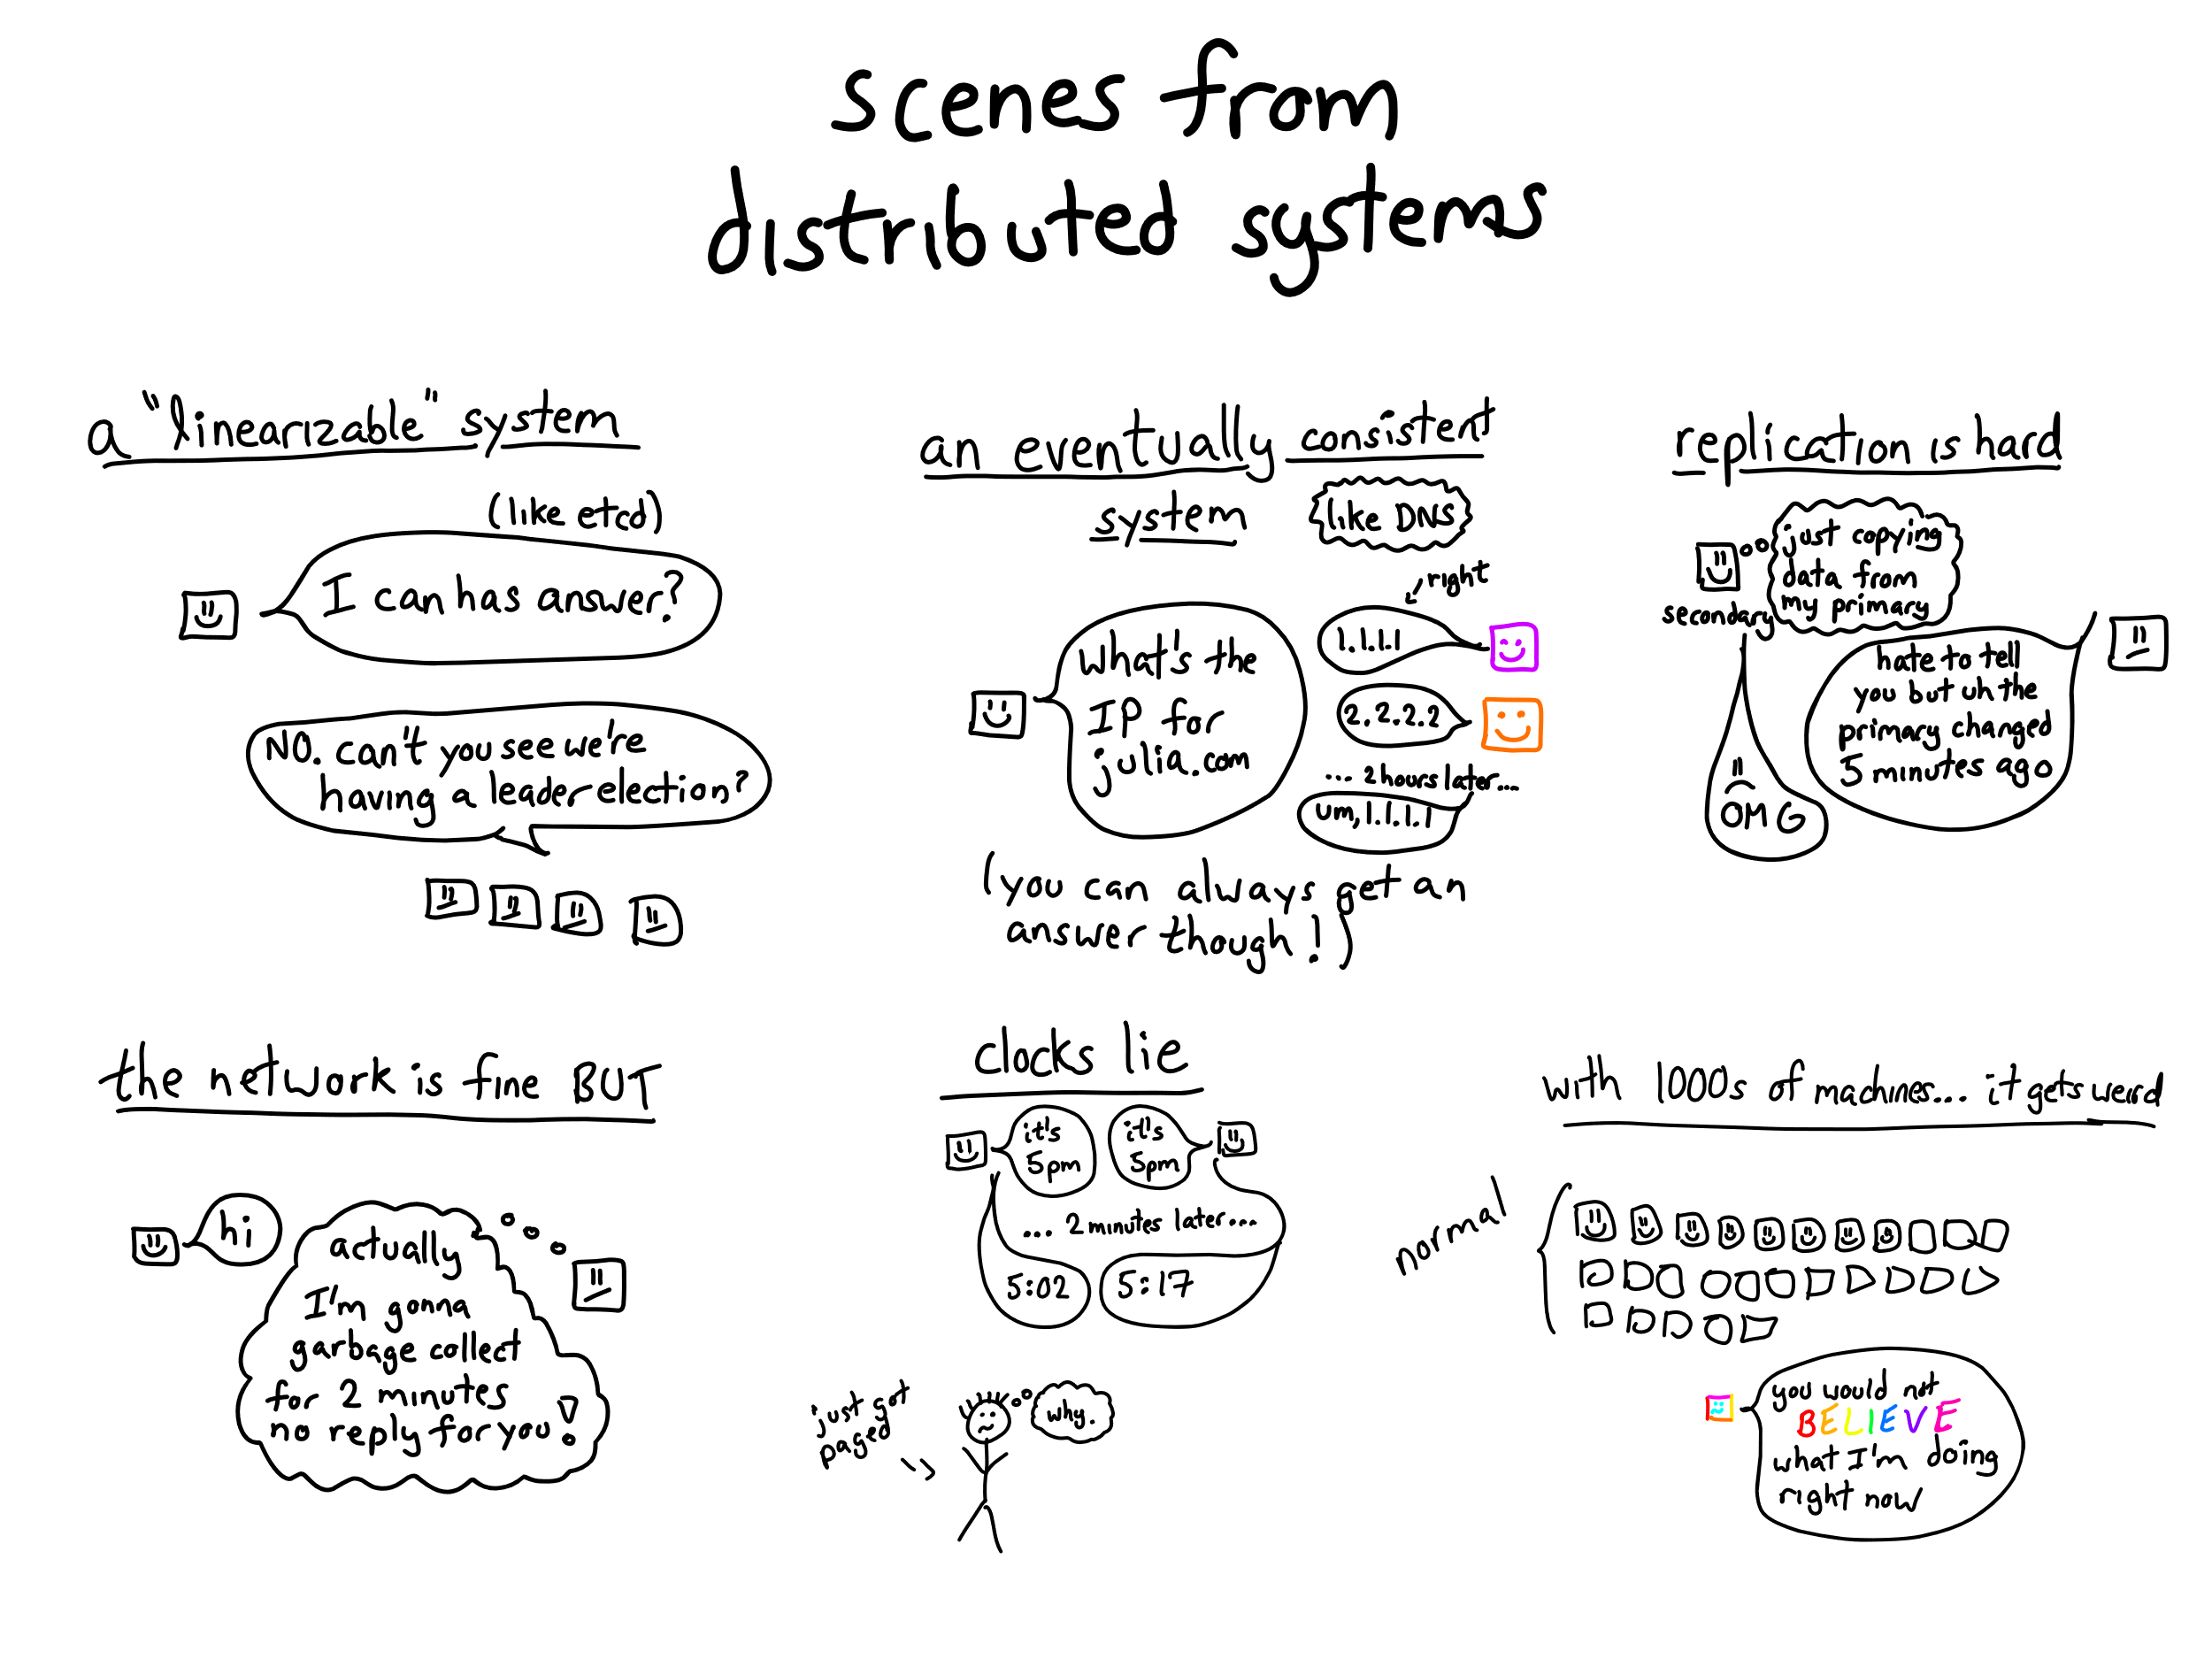
BDS > Big Picture

Slide 4
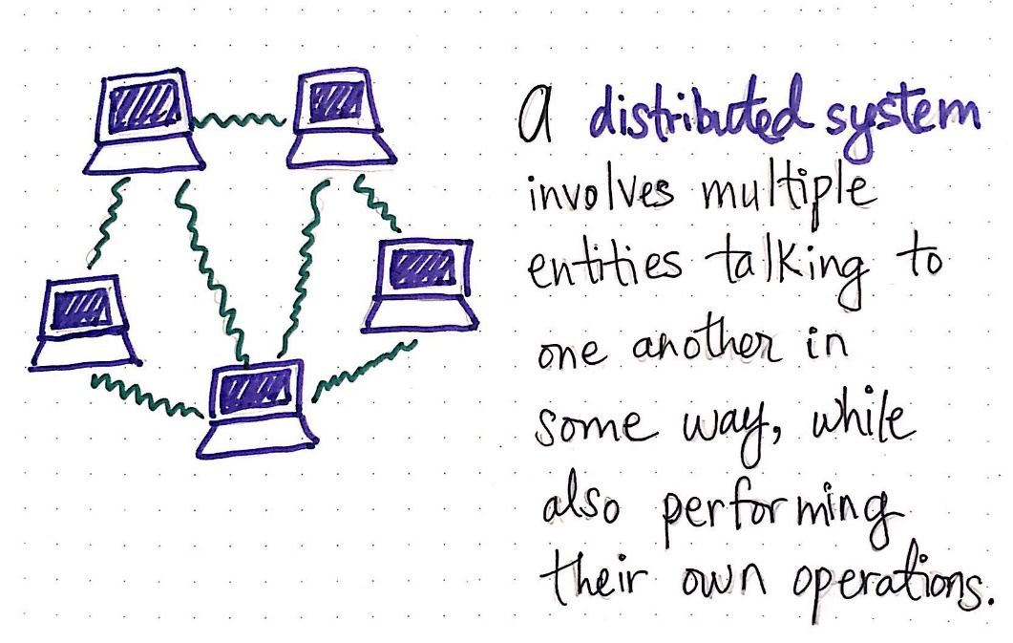
BDS > Big Picture > What is a distributed system?
A collection of computers that work together to form a single computer for the end-users
A collection of computers linked by a network
A collection of computers that share state and operate concurrently
A collection of computers which can fail independently without disrupting the whole system

Slide 5
BDS > Big Picture > Advantages of distributed systems
Modular growth breaks the ceiling on scalability
Horizontal scaling allows distributed systems to service more traffic
Distributed systems are more fault tolerant then centralized systems
Cost effeciency at scale increase return-on-investment
Regional distribution reduces latency for end users
Distributed systems break complex data into smaller pieces (e.g. sharding)
Distributed systems can be designed for parallelism, where multiple processors divide up a complex problem into pieces (e.g. distributed processing)

Slide 6
BDS > Big Picture > Disadvantages of distributed systems
Initial cost of building distributed systems are significantly greater then centralized systems
A distributed system is harder to get up and running due to challenges like clock-synchronization, eventual consistence, replication and network failures
A distributed system is susceptible to cascading errors that can take a long time to debug and fix
CAP theorem forces our distributed system to prioritize availability or consistency when one or more computers are separated by a network partition

Slide 7
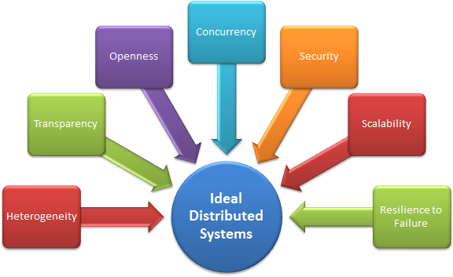
BDS > Challenges

Slide 8

BDS > Challenges > Heterogeneity
Computers may have different instruction-set architectures, leading to binary incompatibility
Computers may have different application binary interfaces and thus interpret memory in different ways (e.g. byte sequence aka endianness)
Library and OS APIs may not be uniformly available to all computers
Computers may have differing types of interconnection (e.g. bus & NICs)
Heterogeneous computing systems makes data partitioning (sharding) more difficult
Notes:
Life-hack #1 => Always use containers

Slide 9
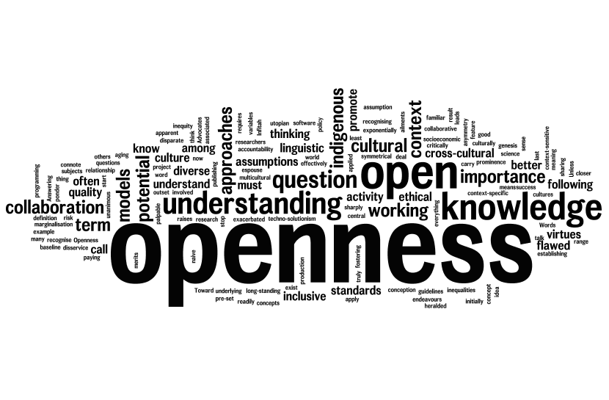
BDS > Challenges > Openness
Systems must conform to well-defined interfaces to avoid fragmentation
Systems must support portability of applications to ensure high availability
Systems should be easy to extend & modify
Systems should be decoupled from the heterogeneity of the underlying hosts
Notes:
Life-hack #2 => Use Open API, Async API and similar ”standards” to publish interfaces & RFCs to govern change

Slide 10
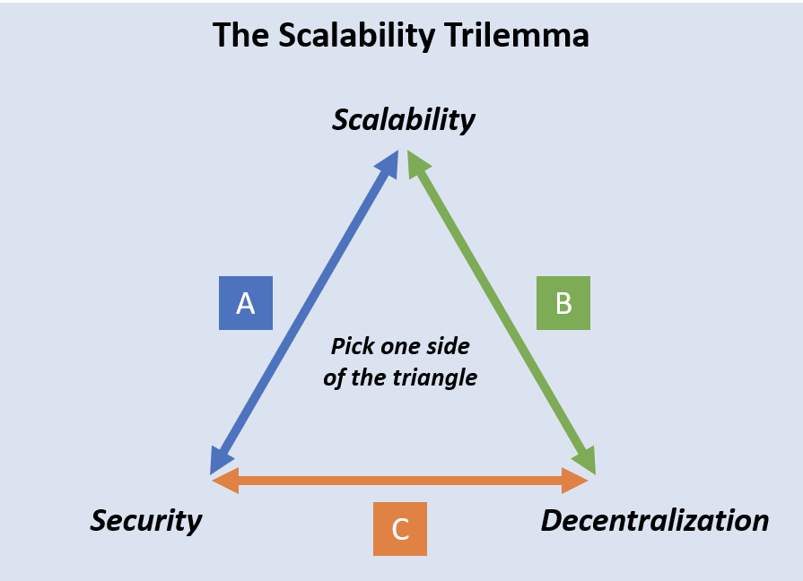
BDS > Challenges > Scalability
No computer has complete information about the system state
Computers make decisions based only on local information
Failure of one computer must not ruin the state of others
There is no implicit assumption that a global clock exists
Notes:
Life-hack #3 => Use Kubernetes, Zero-Trust & OAuth2 (+ OpenId)

Slide 11
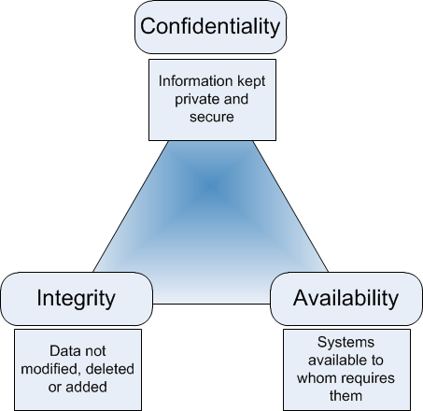
BDS > Challenges > Security
Information must be kept private and secure
Data must not be modified, deleted or added unintentionally
Distributed systems must be available only to its intended audience
How do we identify vulnerabilities?
How do we manage our attack surface?
What resources do we need to protect?
Notes:
Life-hack #4 => Use 3rd party tools like SNYK & Azure AD

Slide 12
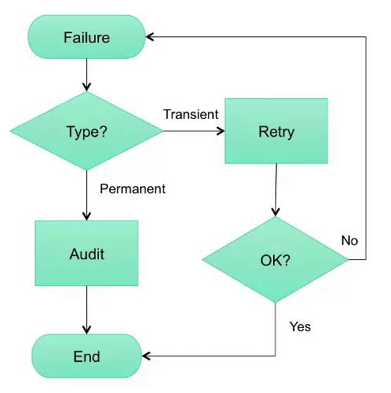
BDS > Challenges > Failure Handling
Detecting failures ranges from trivial (local system) to impossible (remote systems)
Masking failures via message retransmission and/or data replication goes a long way to help stabilize distributed systems
Tolerating failures is sometimes the better option for a distributed system
Recovery from failure is ALOT easier in stateless systems
Notes:
Life-hack #5 => Stateless, eventually consistent, event sourced systems are your friend!

Slide 13
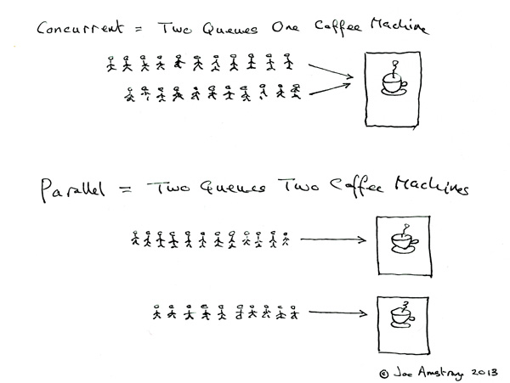
BDS > Challenges > Concurrency
Not all code is thread-safe
Shared resources can lead to deadlocks & race conditions
Concurrent data access is always a trade-off
Notes:
Life-hack #6 => Avoid shared coffee machines!

Slide 14
BDS > Challenges > Transparency
Access transparency dictates that objects must be accessed with the same operations regardless of whether they are local or remote
Location transparency requires objects to be accessible without knowledge of their location
Replication transparency ensures that objects can be replicated without any effect on the applications that use the objects
Concurrency transparency requires concurrent processes to share objects without interference
Failure transparency requires faults to be concealed such that applications can continue to function without any impact on behavior or correctness
Notes:
Life-hack #7 => Adhere to generalized architectural principles & design patterns

Slide 15
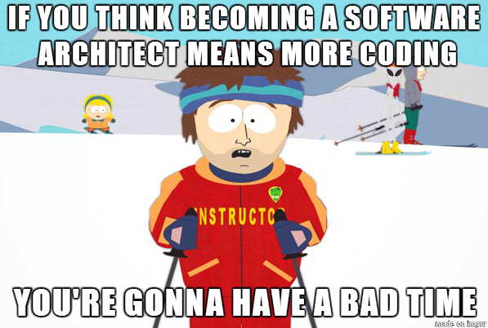
BDS > Principles

Slide 16
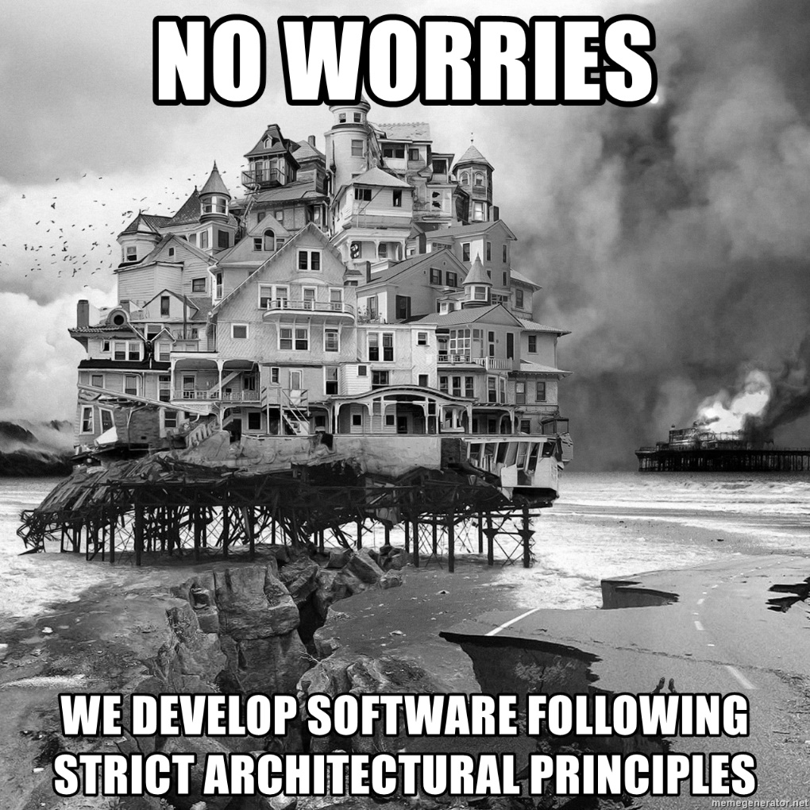
BDS > Principles > Architecture
Build stateless services whenever possible
Design for asynchronous communication
Use containers, always!
Use Kubernetes for orchestration
Monitor as much as possible
Enforce zero-trust guidelines
Build small, release small, fail fast
Automate everything

Slide 17
BDS > Principles > Containers
Every container should address ONLY a single concern
A container should rely only on the presence of the Linux kernel and have any additional libraries added to it at the time the container is built
Containerized applications are meant to be immutable, and once built are not expected to change between different environments
Every container must implement all necessary APIs to help the platform observe and manage the application in the best way possible
Containerized applications need to be as ephemeral as possible and ready to be replaced by another container instance at any point in time
Every container should declare its resource requirements explicitly

Slide 18
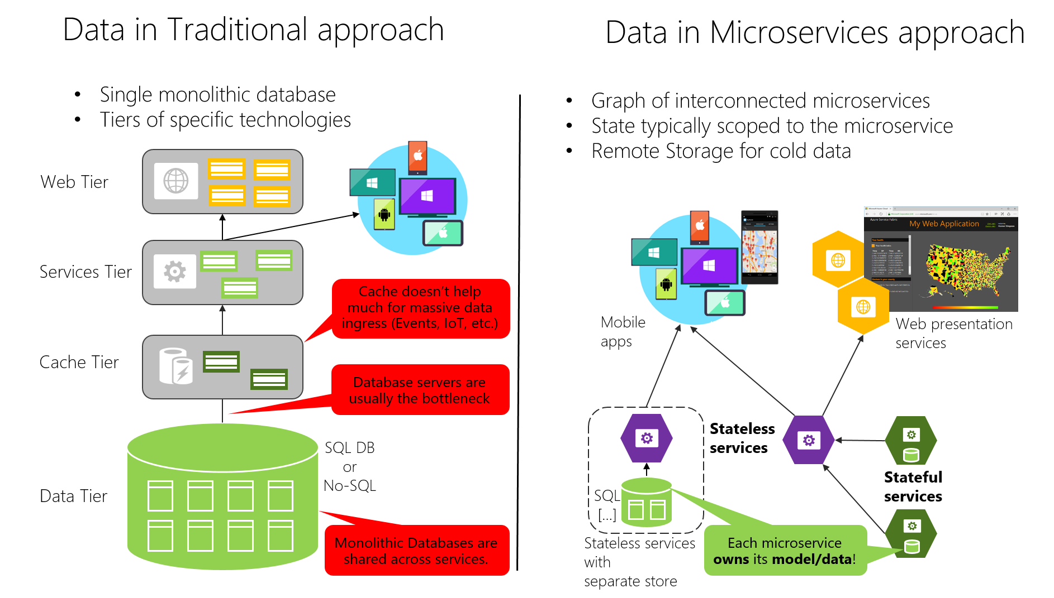
BDS > Principles > Microservices
Logical architecture doesn't have to coincide with the physical architecture
Enforce data sovereignty per microservice
Prioritize asynchronous event-driven communication
Always implement health checks and logging
Use API gateways for aggregation

Slide 19
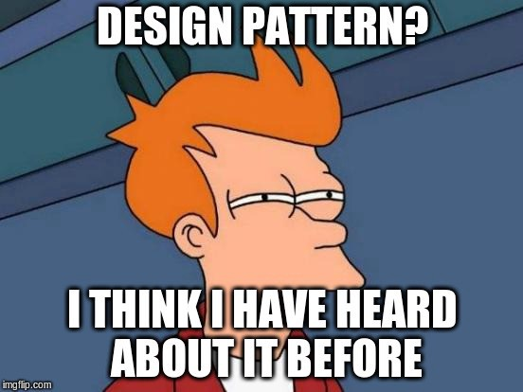
BDS > Patterns

Slide 20
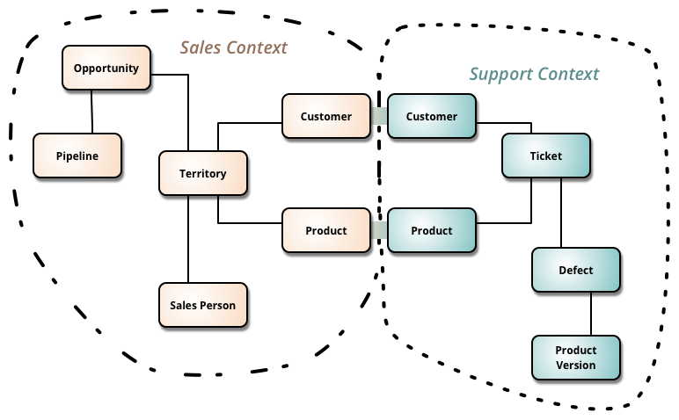
BDS > Patterns > Bounded Contexts
Bounded Context deals with large models by dividing them into different “domains” and being explicit about their interrelationships.
Bounded Contexts are important because total unification of the domain model for a large system is not feasible or cost-effective
Various factors draw boundaries between contexts, however in general Bounded Contexts tend to adhere to Conway's law

Slide 21
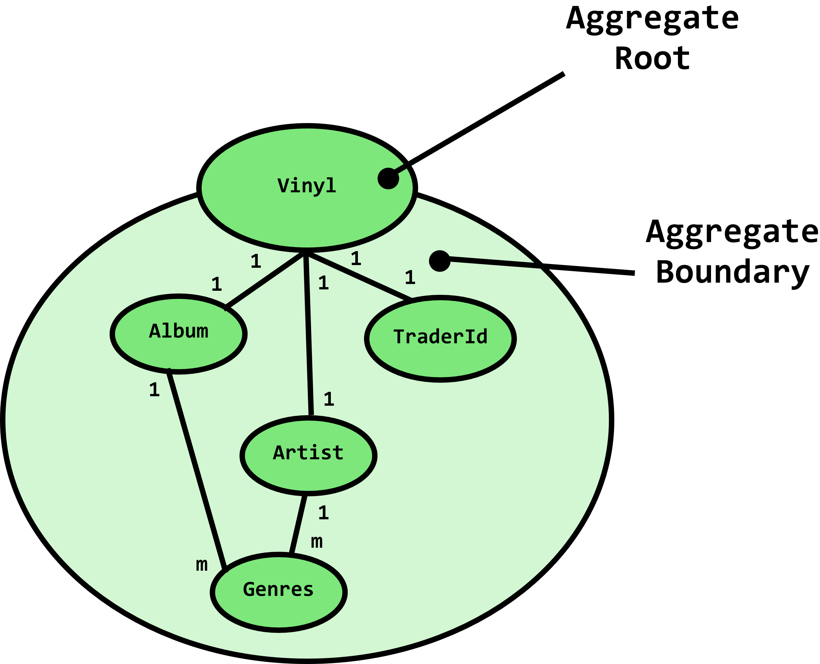
BDS > Patterns > Aggregates
An aggregate is a cluster of domain objects that can be treated as a single unit
An aggregate will have one of its component objects be the aggregate root. Any references from outside the aggregate should only go to the aggregate root
Aggregates are the basic element of transfer of data storage - you request to load or save whole aggregates. Transactions should not cross aggregate boundaries

Slide 22
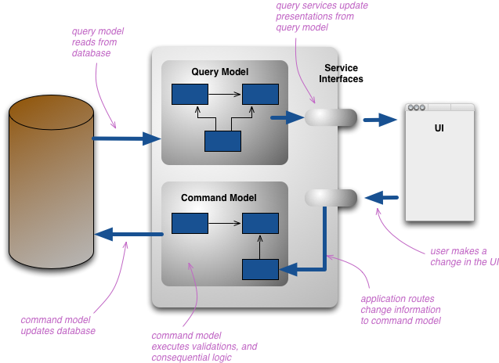
BDS > Patterns > CQRS
CQRS stands for Command Query Responsibility Segregation
CQRS splits the conceptual model into separate models which allows us to optimize for reads & writes independently
CQRS is best suited for complex domains that leverages event-based programming models and eventual consistency
For simple domains CRUD is typically a better alternative

Slide 23
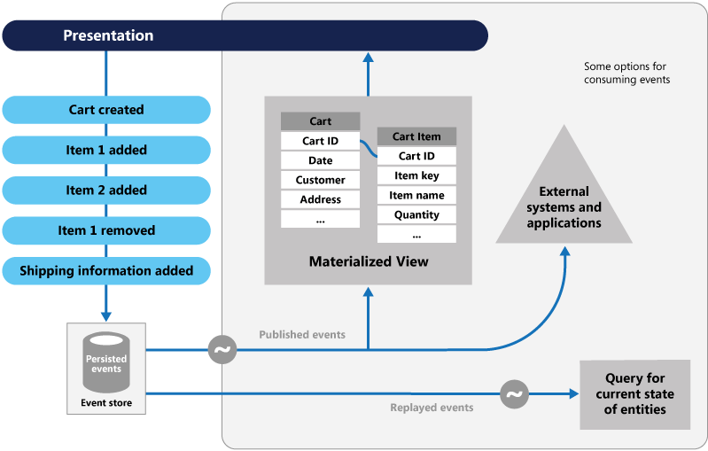
BDS > Patterns > Event Sourcing
Event Sourcing allows us to handle operations on data as a sequence of events, each of which is recorded in an append-only store
Events are persisted in an event store that acts as the system of record (the authoritative data source) about the current state of the data
The event store raises events, and tasks perform operations in response to those events. This decoupling of the tasks from the events provides flexibility and extensibility
Temporal queries are kind cool!

Slide 24
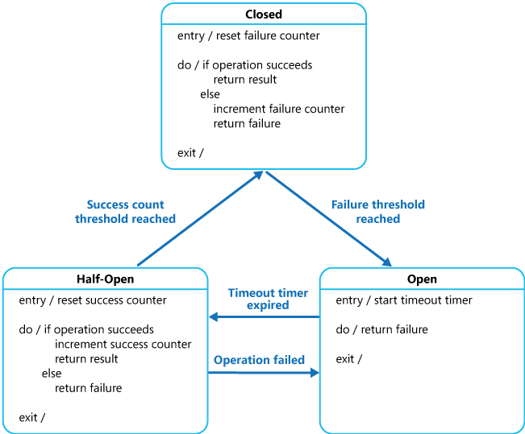
BDS > Patterns > Circuit breaker
Circuit Breakers prevent catastrophic cascades in distributed systems
Circuit breakers wrap protected function calls and monitors for failures
Circuit breakers enables external intervention via alerting when faced with unrecoverable system states

Slide 25
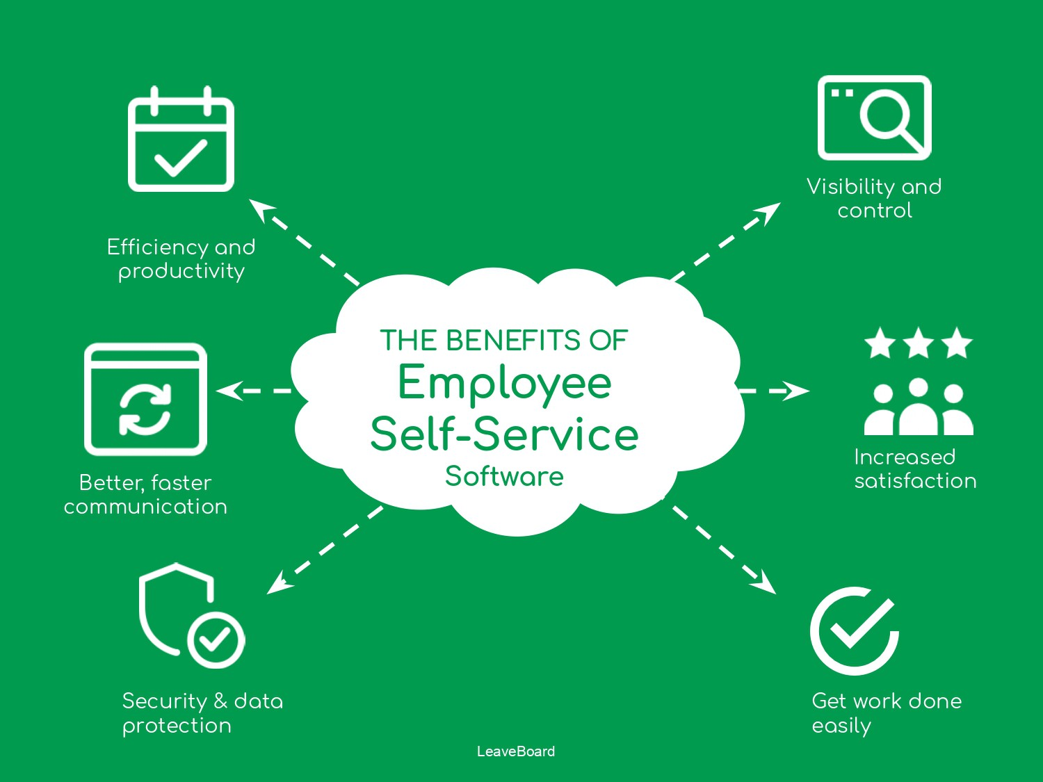
BDS > Case Study

Slide 26

BDS > Case Study > Demo

Slide 27
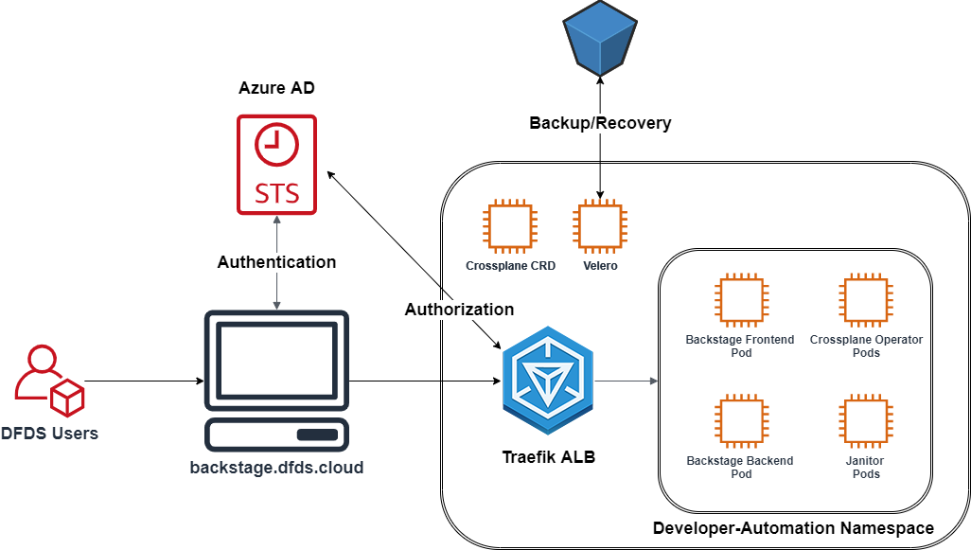
BDS > Case Study > Concept
All interactions within the system are governed by Azure AD
Crossplane enables dynamic provisioning for various cloud and custom resources
Cluster state is replicated by Velero to an offsite location
Developers manage their capabilities via a central portal
Developer-Automation provides custom support services for our Self-Service platform
ForwardAuth verifies inbound bearer tokens via Azure AD

Slide 28
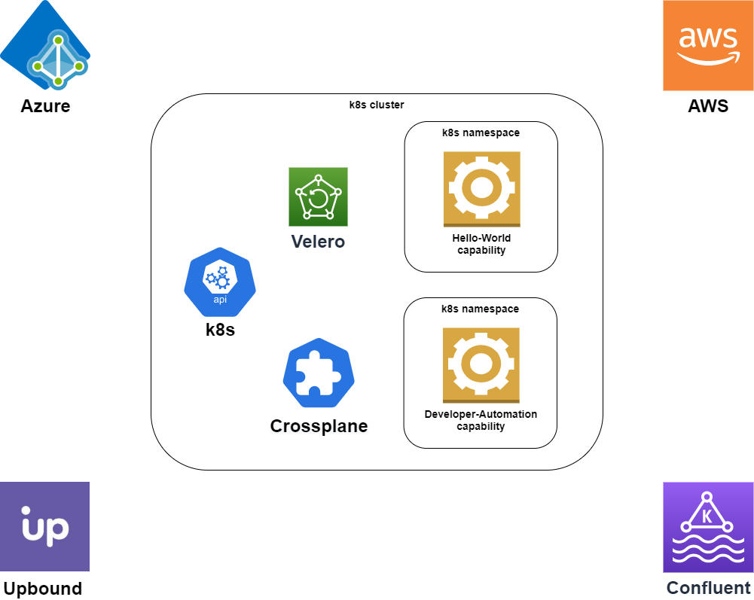
BDS > Case Study > Concept > Outer Architecture
Velero ensures that workloads & resources are backed up and can easily be restored in case of emergency
K8s provides the platform for our platform
Capabilities are bounded contexts belonging to stream-aligned teams that provide them with a well defined boundary for their microservice. In general capabilities represent well defined business responsibilities within DFDS
Developer-Automation acts as a control plane for all DFDS capabilities and is managed by platform teams
Crossplane provides a unified service broker for all our external cloud dependencies

Slide 29
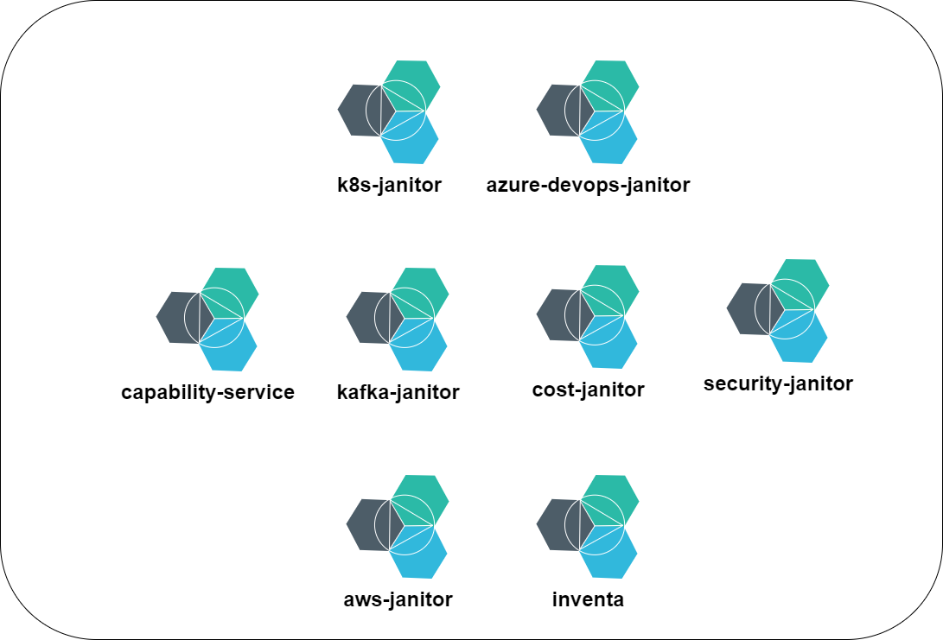
BDS > Case Study > Concept > Inner Architecture
Façade @ k8s
Façade @ Azure DevOps
Manages capability lifecycles and meta data
Monitors cost of capabilities
Scans and evicts workloads that have been compromised
Façade @ Amazon Web Services
Façade @ Confluent Cloud
Service discovery

Slide 30
BDS > Literature
https://martinfowler.com/
https://www.brainkart.com/article/The-Challenges-in-Distributed-System_8526/
https://www.educative.io/blog/distributed-systems-considerations-tradeoffs
https://d2iq.com/blog/containers-distributed-systems
https://docs.microsoft.com/en-us/dotnet/architecture/microservices
https://docs.microsoft.com/en-us/azure/architecture/patterns/
https://medium.com/@jym/beyond-confidentiality-integrity-availability-fbe4a64f69c4

Slide 31

BDS > Q&A

